Slide 1

Proofs 7
Induction
By ariel Avshalom

Slide 2
We’ve covered many methods of proofs
Now its times to learn an “advanced method”

Slide 3
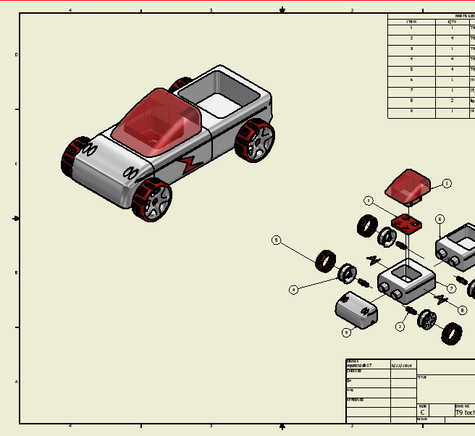
Induction and Recursion
Who here has heard of either of these?
For now, you need to know that induction “builds” the space, while recursion is used to “solve” problems in the space
Constructing with the stuff (solve problems)
The stuff (define and create it)

Slide 4

How does induction work?
Let’s start by asking a question:
Does the sum of the first n odd natural numbers equal $n^{2}$?
Let’s try it out:
$$\sum_{0}^{n}{2n+1}={(n+1)}^{2}$$

Slide 5
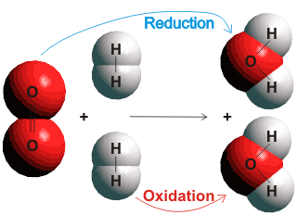
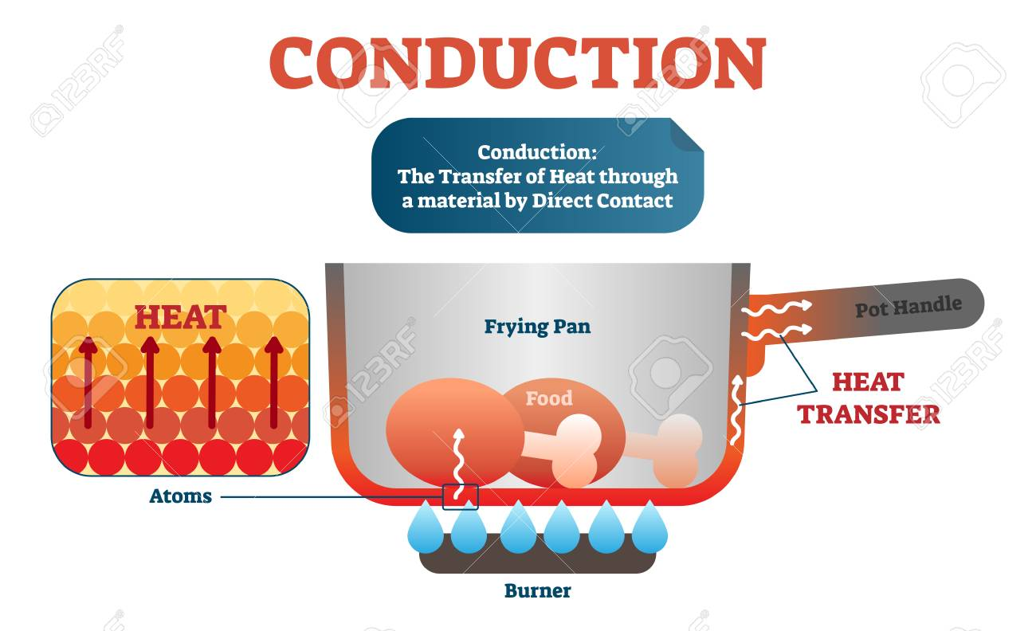
So how can we prove this is true?
Use this concept called induction.
NO
Not Conduction
Or Reduction,
But INDUCTION!

Slide 6
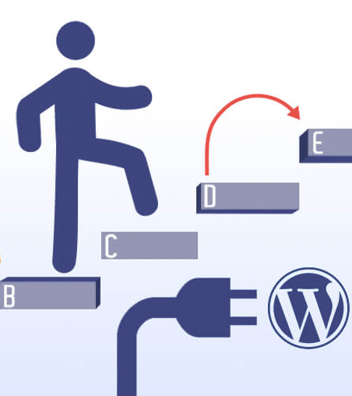
Induction proofs have 3 steps:
Prove a base case
Create an inductive step to n (logical assumption)
Show that your assumption works for n+1

Slide 7


Looking back:
Prove that
$$\sum_{0}^{n}{2n+1}={(n+1)}^{2}$$
Prove the base case
Assume to n
Show true for n+1

Slide 8
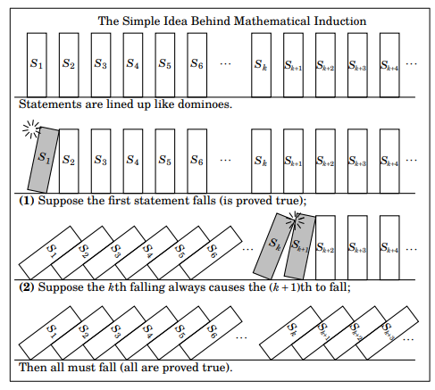
Book’s representation
Sort of like https://www.youtube.com/watch?v=tj7al6MXu7U
Or
https://www.youtube.com/watch?v=Q0jeohWnmAQ

Slide 9
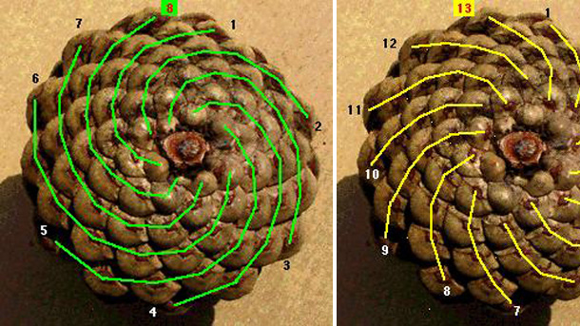
Another example: Fibonacci
This is sooooo similar to induction, but it isn’t. This is recursion.
Recursion is when one entry in a sequence is built up of terms from earlier entries.

Slide 10
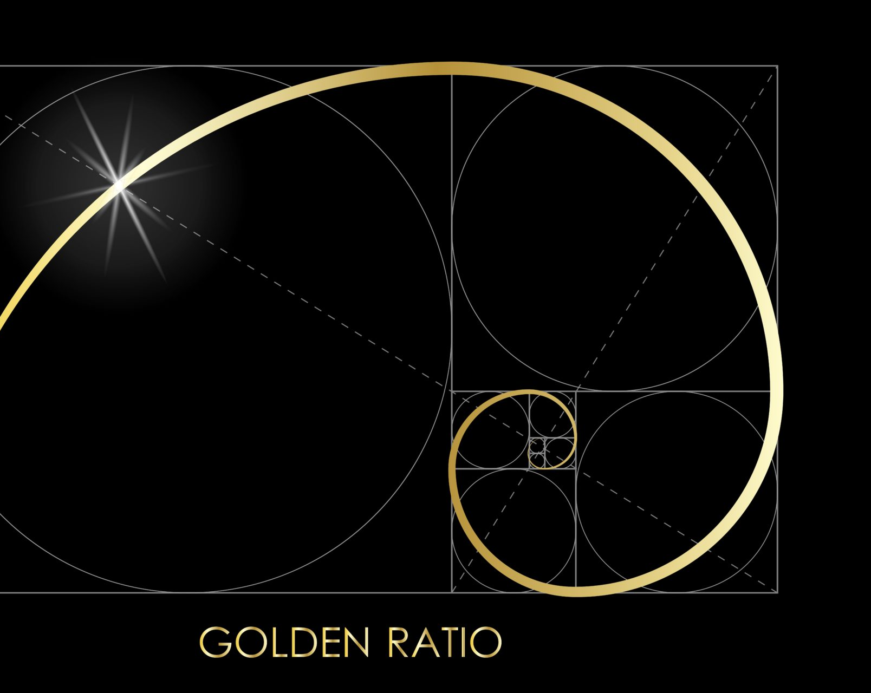

Fibonacci
What is the Fibonacci sequence?
1,1,2,3,5,8,13,21,34,55,…
In more precise terms:
$$f_{n+1}=f_{n}+f_{n−1}$$
$$f_{3}=f_{2}+f_{1} ≡ 2=1+1$$
$$f_{4}=f_{3}+f_{2} ≡ 3=2+1$$

Slide 11
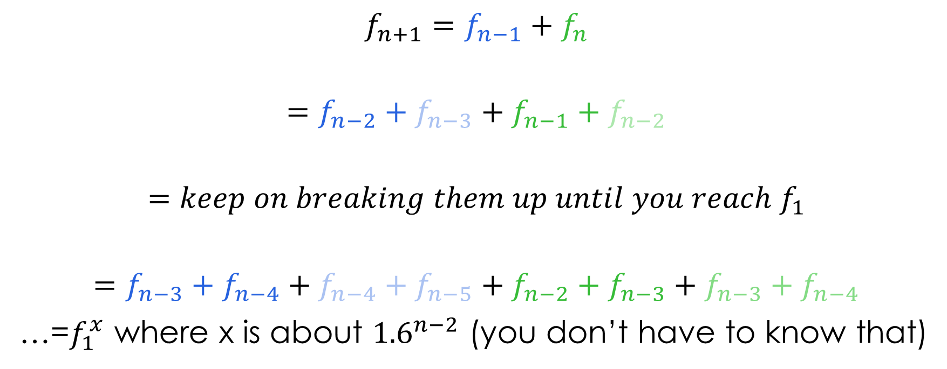
What we need to understand
$${f_{n+1}=f_{n−1}+f}_{n}$$
$$=f_{n−2}+f_{n−3}+f_{n−1}+f_{n−2}$$
$$=keep on breaking them up until you reach f_{1}$$
$$=f_{n−3}+f_{n−4}+f_{n−4}+f_{n−5}+f_{n−2}+f_{n−3}+f_{n−3}+f_{n−4}$$
…=$f_{1}^{x}$ where x is about ${1.6}^{n−2}$ (you don’t have to know that)

Slide 12
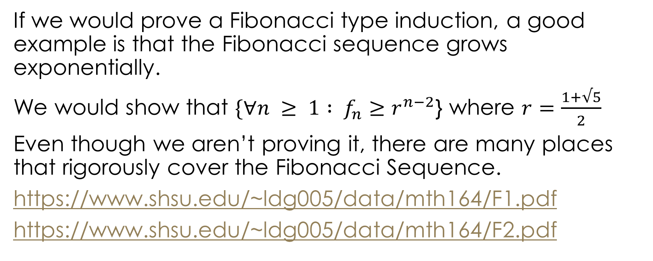
We won’t prove Fibonacci Theorems here
If we would prove a Fibonacci type induction, a good example is that the Fibonacci sequence grows exponentially.
We would show that $\{∀n ≥ 1 : f_{n}≥r^{n−2}$} where $r=\frac{1+√5}{2}$
Even though we aren’t proving it, there are many places that rigorously cover the Fibonacci Sequence.
https://www.shsu.edu/~ldg005/data/mth164/F1.pdf
https://www.shsu.edu/~ldg005/data/mth164/F2.pdf

Slide 13

Golden ratio $φ$
The Fibonacci Pattern is seen throughout all of nature. In art, music, botany, beauty, everywhere.
Cool animation: https://www.youtube.com/watch?time_continue=192&v=kkGeOWYOFoA&feature=emb_logo
Good Numberphile video: https://www.youtube.com/watch?v=Nu-lW-Ifyec
Those videos about magic numbers given in the first lecture probably also mention Fibonacci
Ted: https://www.youtube.com/watch?v=SjSHVDfXHQ4

Slide 14
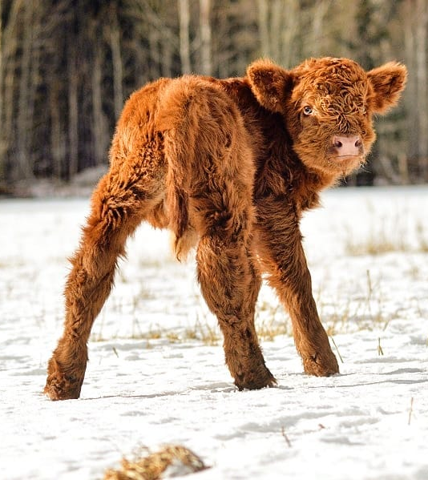

Some fun: lifting a cow (improper induction)
When a calf is born, its very easy to lift
Let’s call lifting out function f
On $f_{1}$(day 1) it is super easy to lift the calf
So our base case is true
Let’s assume this is true for $f_{n}$ we need to show truth for $f_{n+1}$
This works for say the first 6 months, but afterwards it becomes impossible.

Slide 15
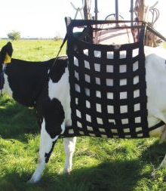
What happened?
We didn’t define our lift function properly
We assume there is no change on the calf every day, but it undergoes growth (way beyond scope of class ☺)
Which means that our whole assumption is incorrect
Remember, definitions are important! (We didn’t even properly define lifting!!)

Slide 16
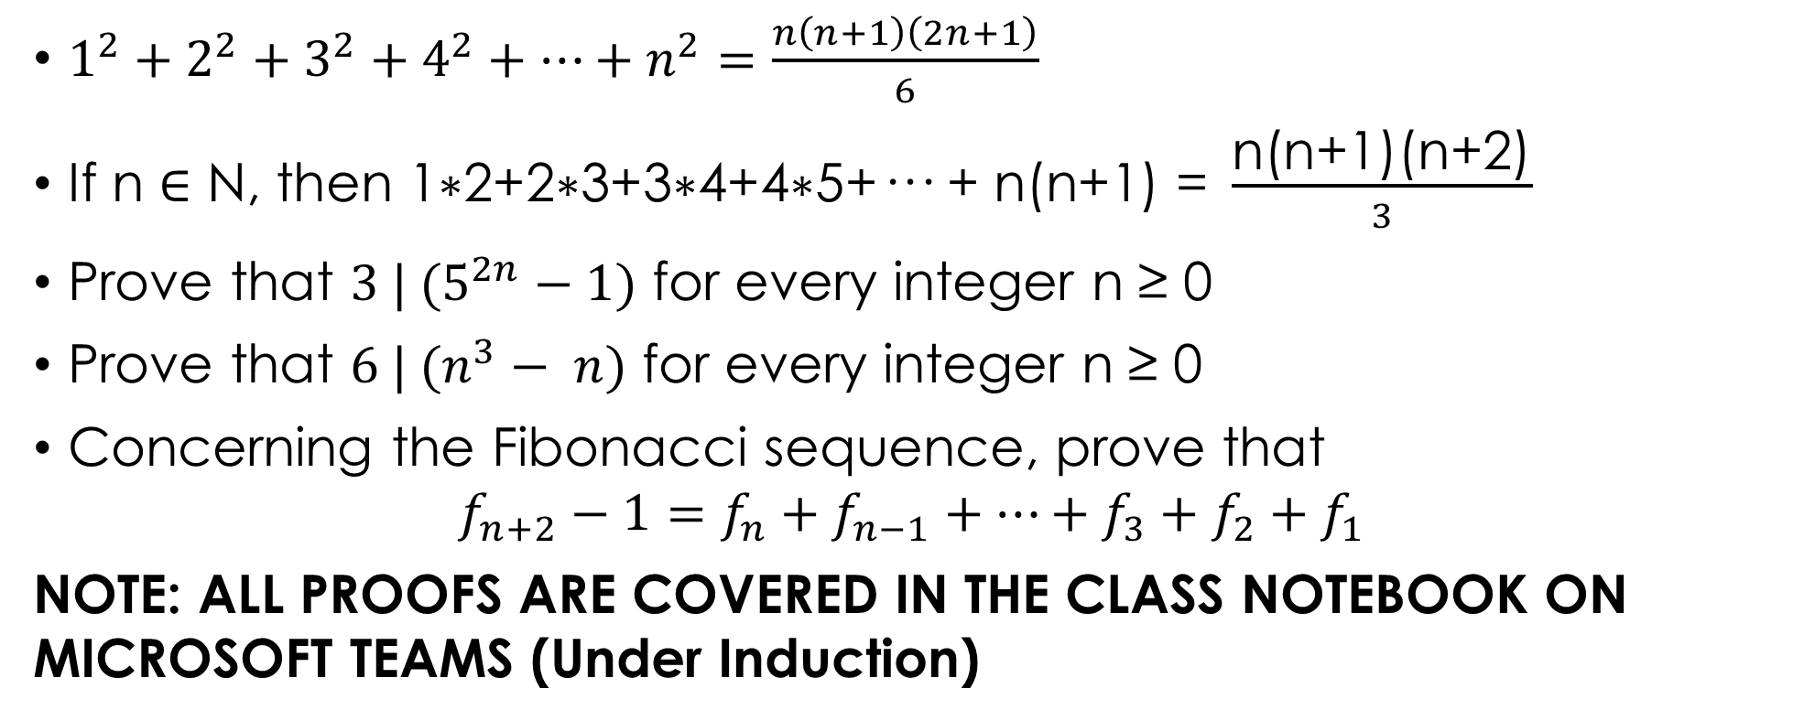
Some examples:
$1^{2}+2^{2}+3^{2}+4^{2}+…+n^{2}=\frac{n\left(n+1\right)\left(2n+1\right)}{6}$
$\text{If} \text{n}\text{ ∈ }\text{N}\text{, }\text{then}\text{ 1}\text{∗}\text{2+2}\text{∗}\text{3+3}\text{∗}\text{4+4}\text{∗}\text{5+··· + }\text{n}\text{(}\text{n}\text{+1) = }\frac{\text{n}\text{(}\text{n}\text{+1)(}\text{n}\text{+2)}}{3}$
Prove that $3 | (5^{2n}−1)$ for every integer n ≥ 0
Prove that $6 | (n^{3}− n)$ for every integer n ≥ 0
Concerning the Fibonacci sequence, prove that
$$f_{n+2}−1=f_{n}+f_{n−1}+…+f_{3}+f_{2}+f_{1}$$
NOTE: ALL PROOFS ARE COVERED IN THE CLASS NOTEBOOK ON MICROSOFT TEAMS (Under Induction)

